Slide 1



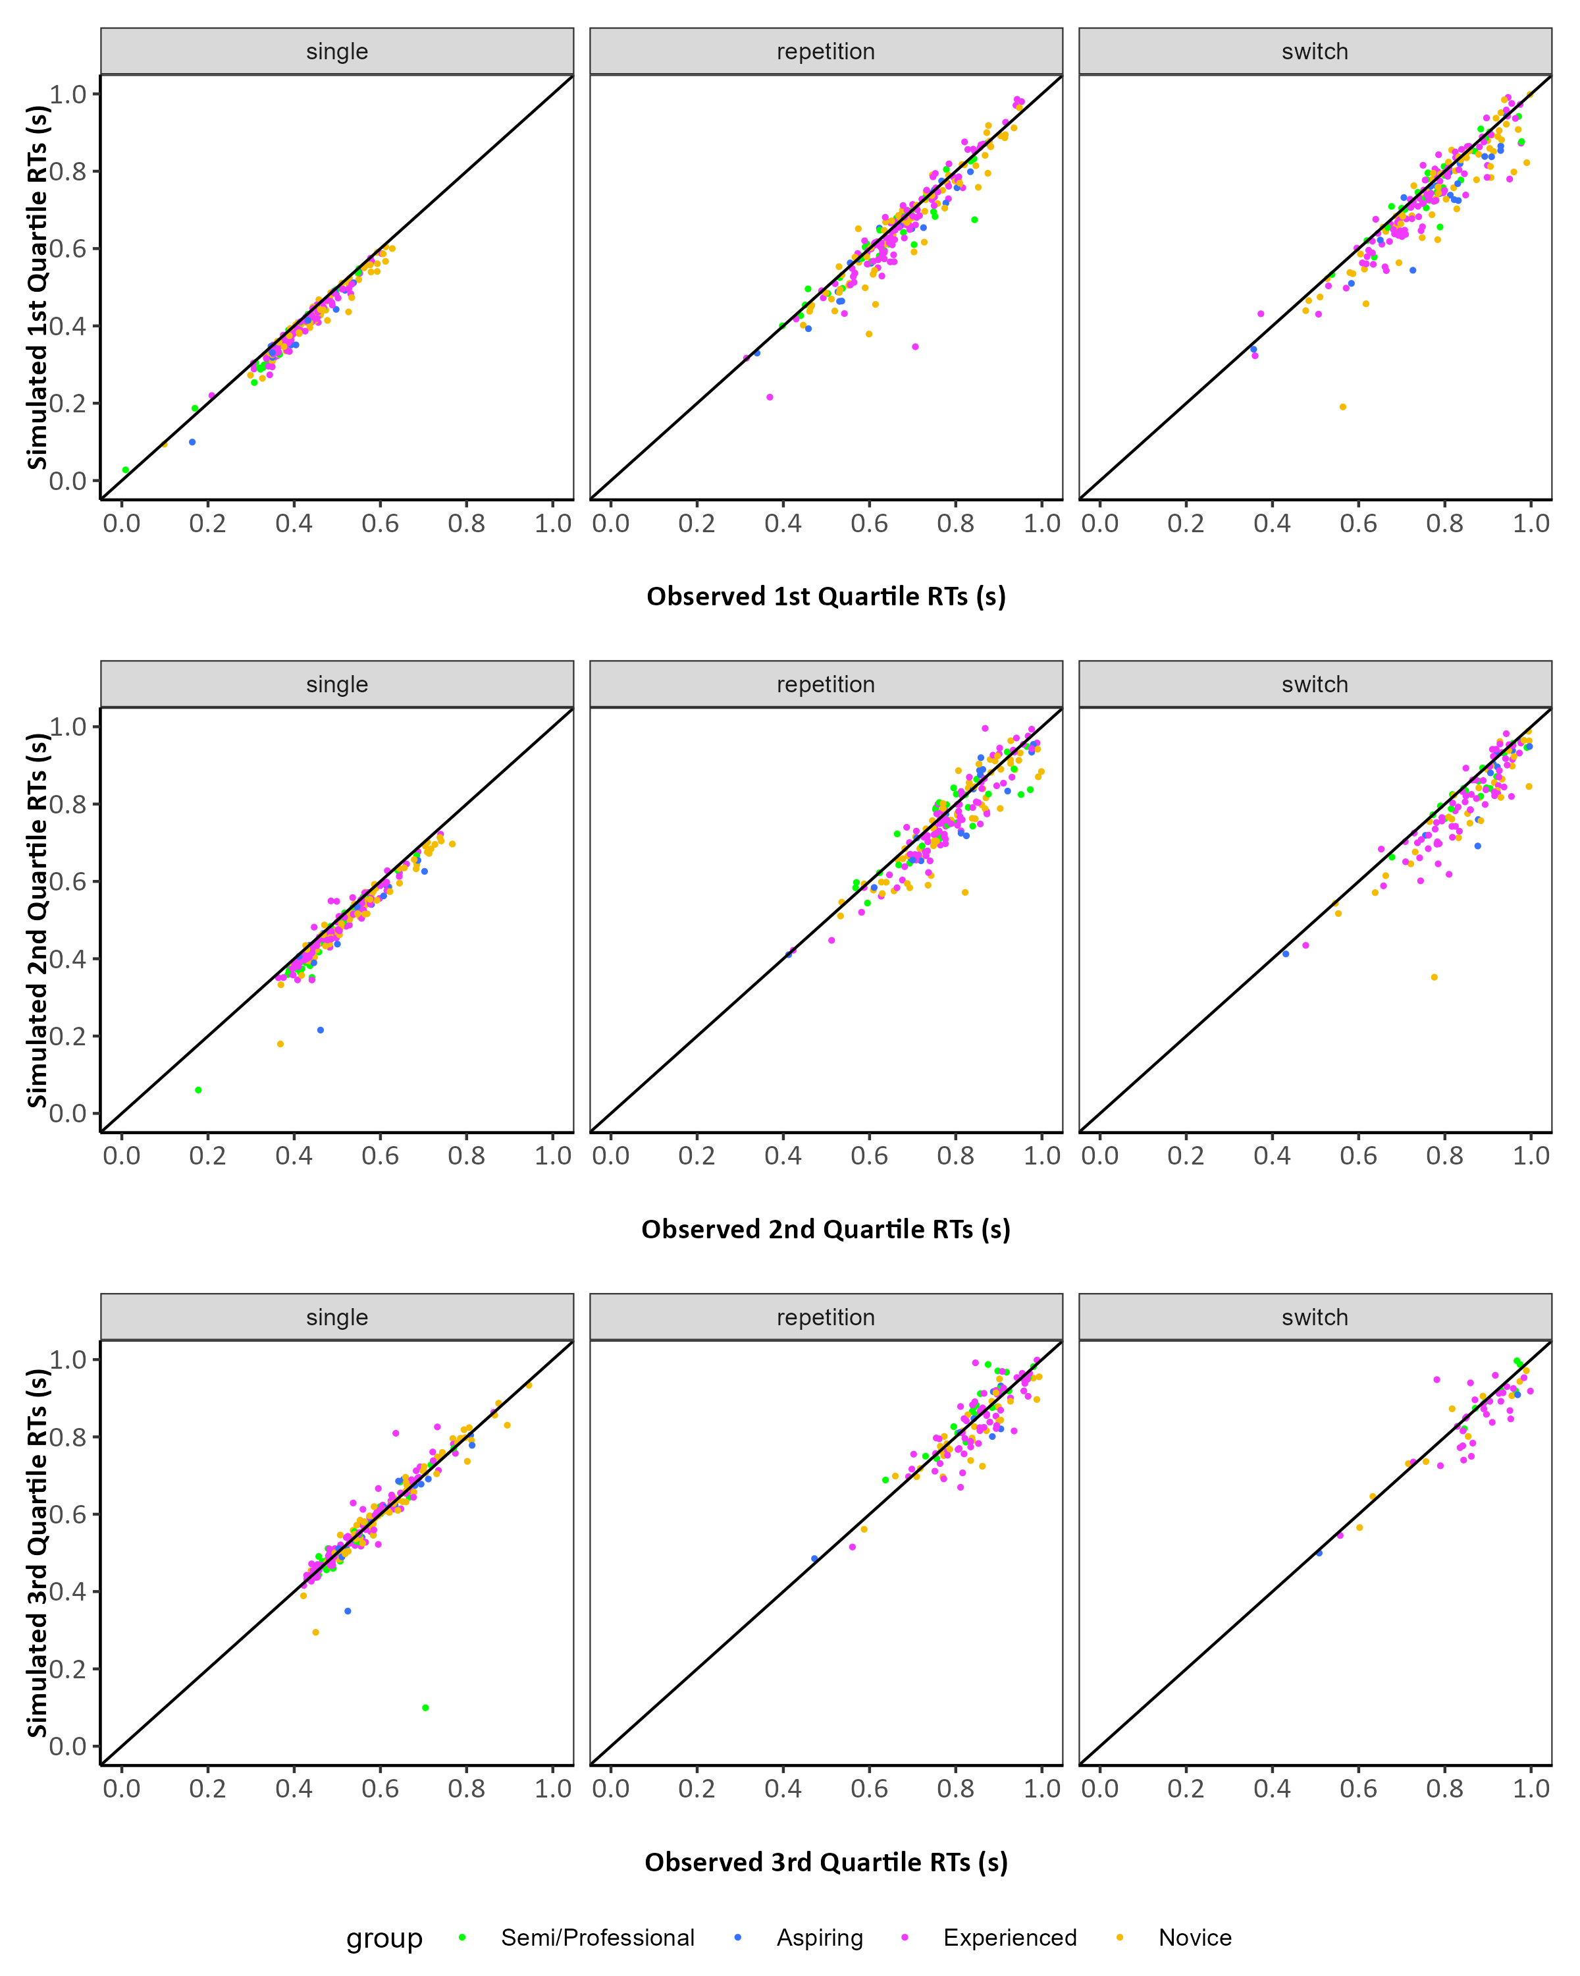
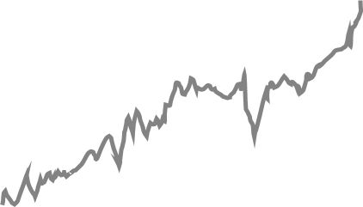
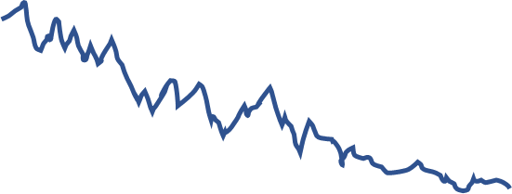
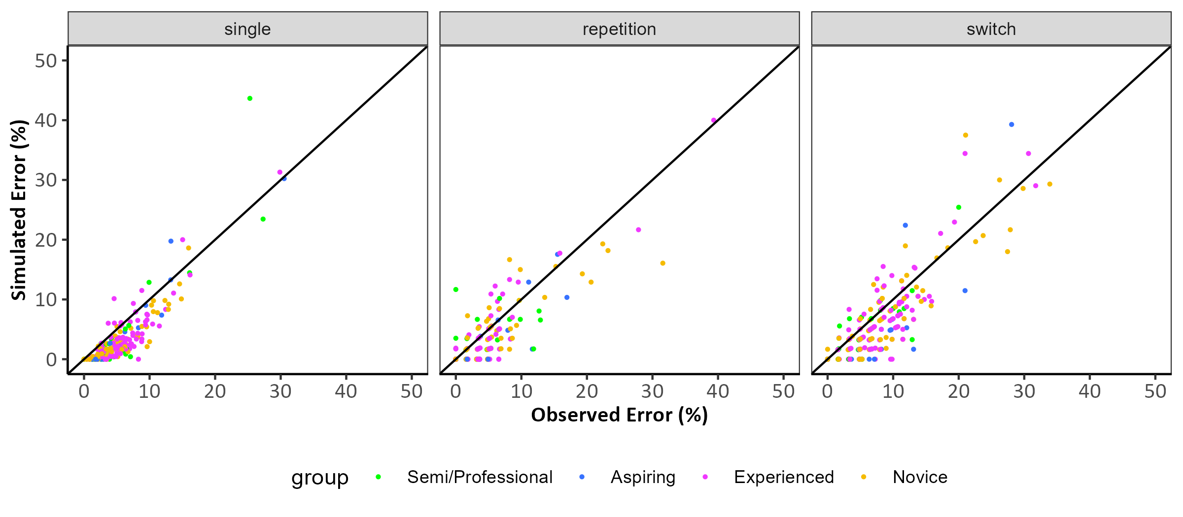

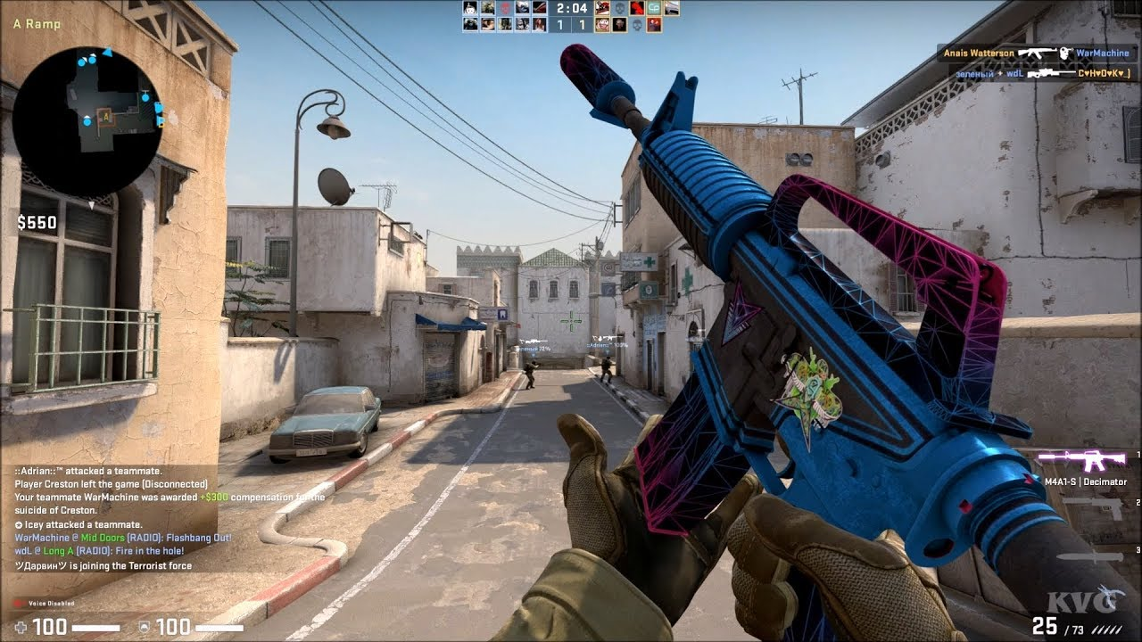
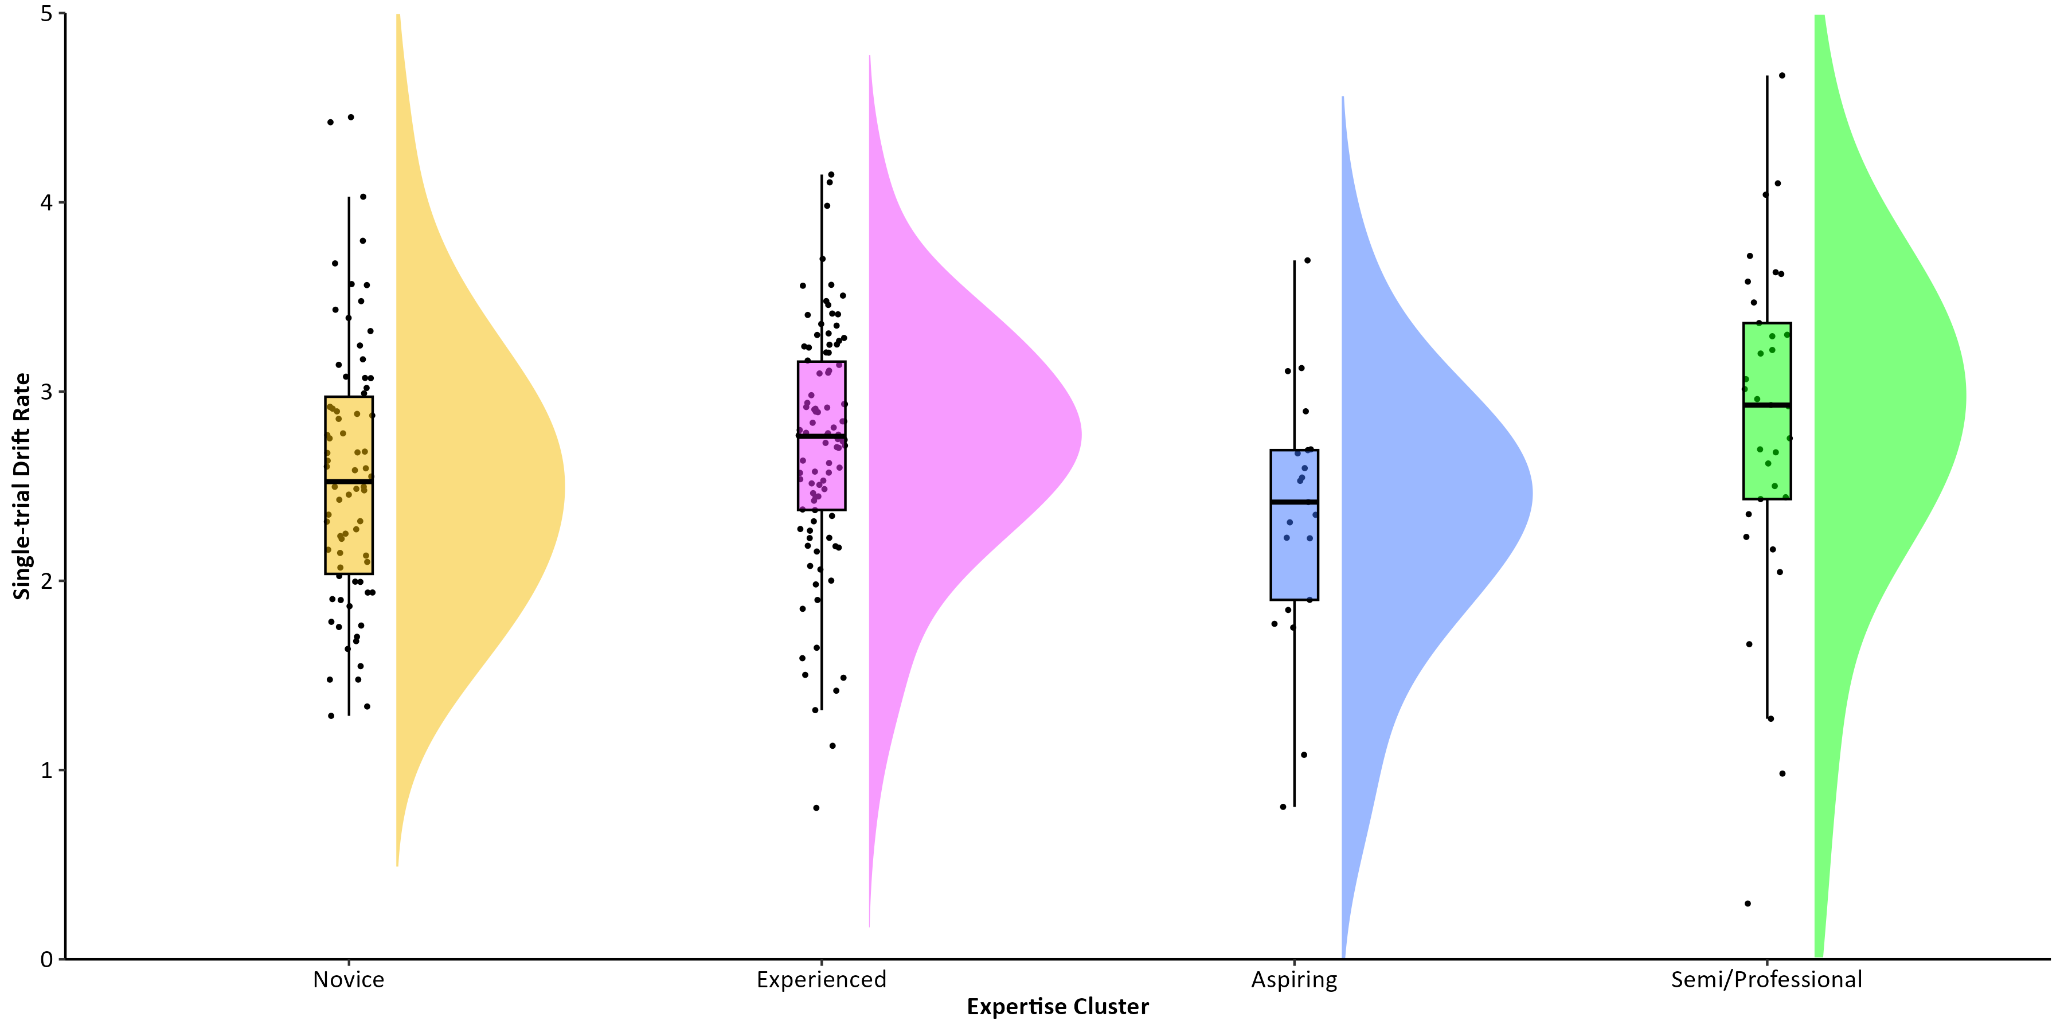
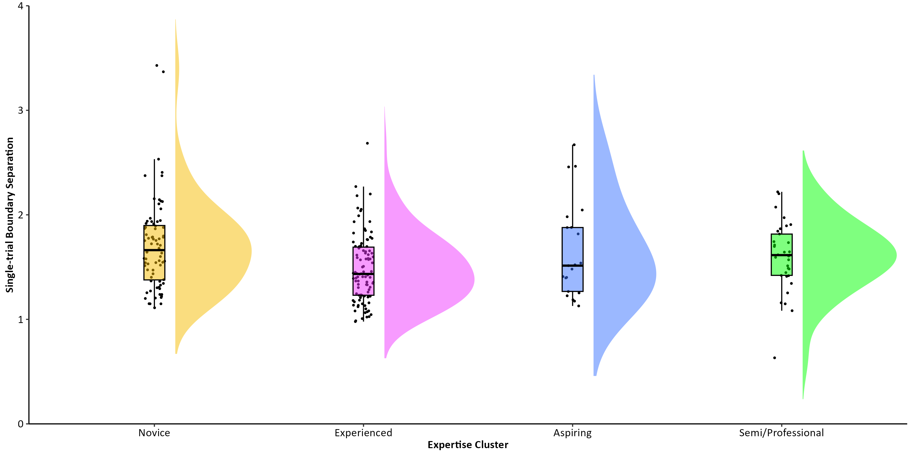
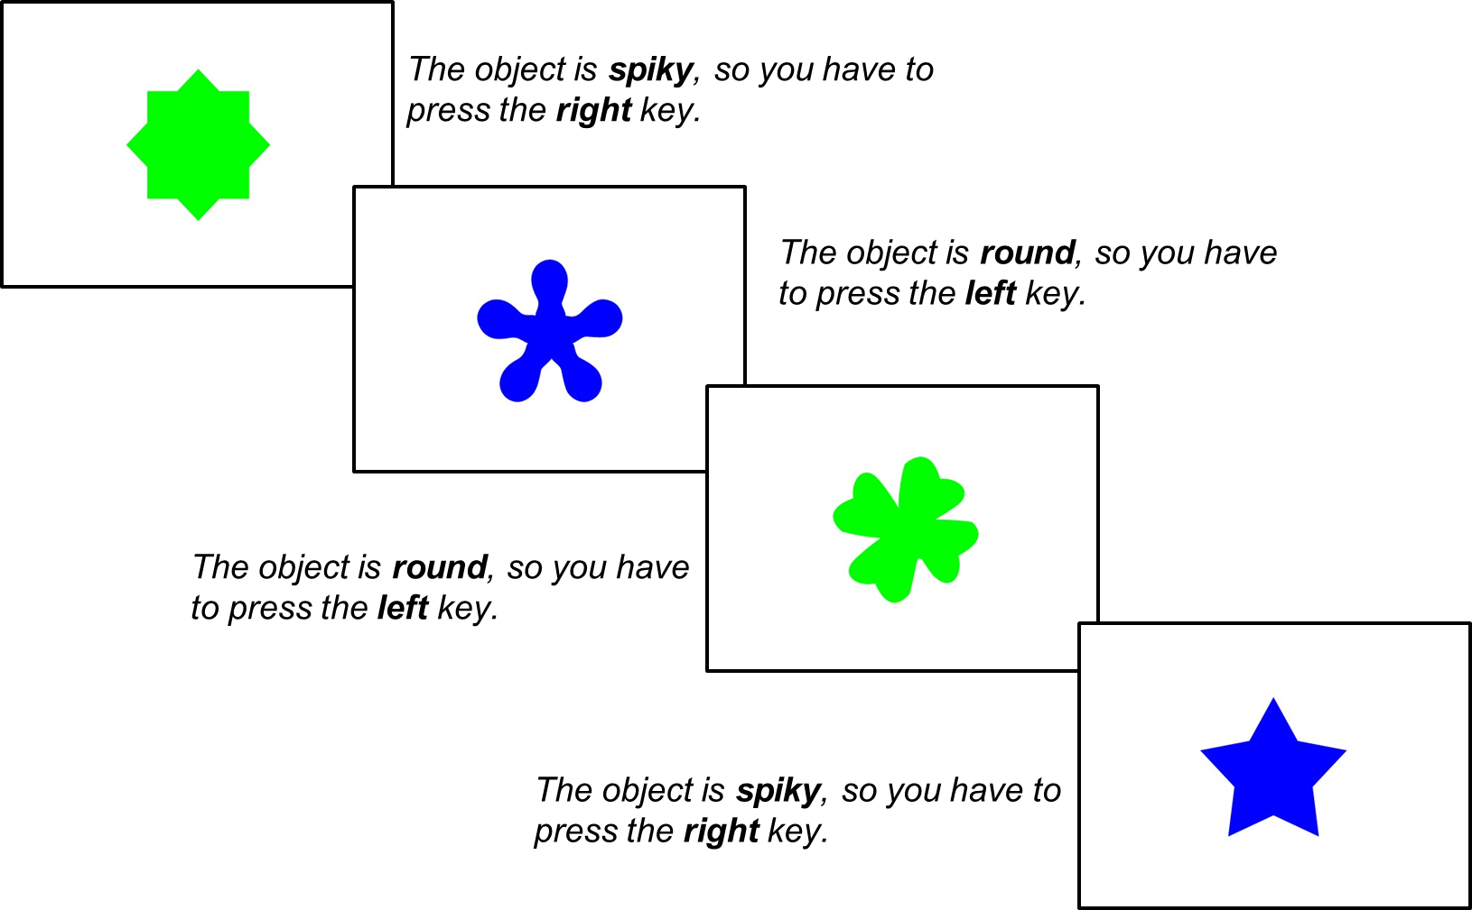

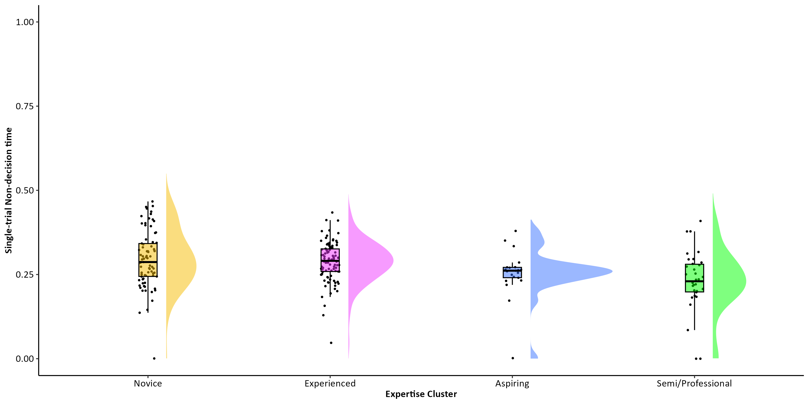
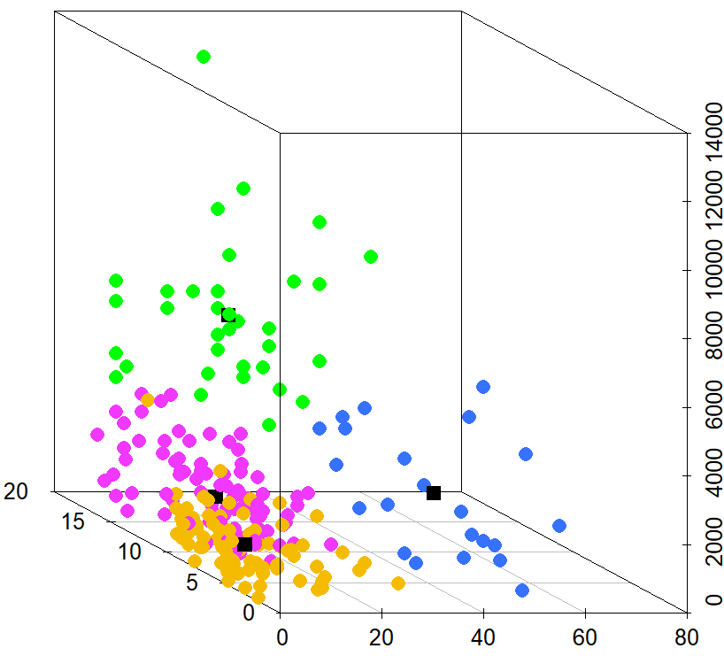
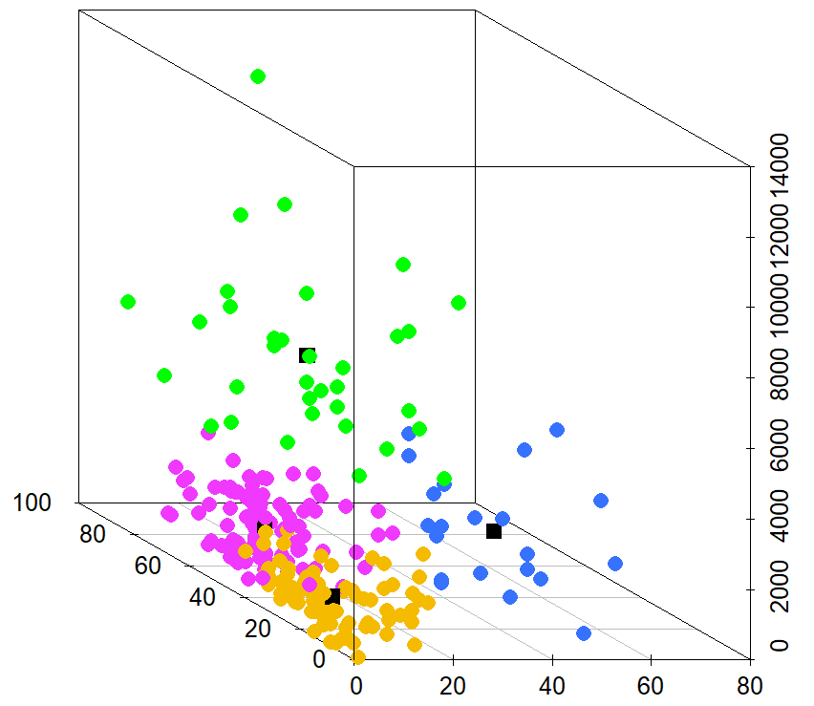
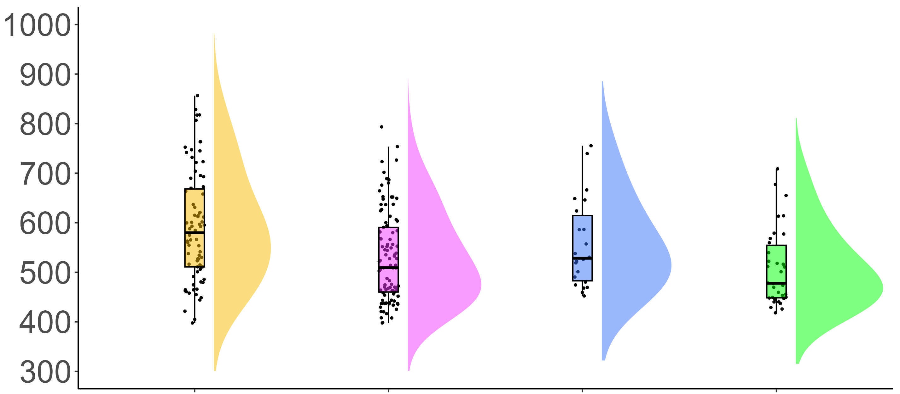

COGNITIVE CORRELATES OF ACTION VIDEO GAMING: A CROSS-SECTIONAL STUDY OF COUNTER-STRIKE PLAYERS
Eleanor R. A. Hyde, Robert Schmidt, Daniel J. Carroll, & Claudia C. von Bastian
erahyde1@sheffield.ac.uk eleanorhyde.com @era_hyde
Drift-Diffusion Modelling
Background
Action video games (AVGs) are fast-paced, dynamic video games which require quick decision-making.
Research shows an inconsistent association between AVG play and processing speed^{1, 2}.
By decomposing reaction times (RTs) using the drift-diffusion model (DDM)³, researchers found AVG training to improve drift rates⁴, whilst others found AVG training to increase boundary separations² .
These mixed findings may be due to methodological limitations such as small samples, broad definitions of AVGs.
It remains unclear how to measure AVG expertise if there is a relationship between AVG expertise and processing speed.
Counter-strike: Global Offensive (CS:GO) is a popular AVG and the focus of this study.
Correct response
Starting point
Boundary Separation
Drift rate
Incorrect response
Stimulus encoding
Decision time
Response execution
F(3, 226) = 2.20, p = .089, BF = 0.29 ± 0.00%
Research Questions
Drift Rate (v)
How should CS:GO expertise be measured?
Is greater CS:GO expertise associated with faster processing speed?
Do the decision processes underlying processing speed differ with CS:GO expertise?
M = 2.68 (0.90)
M = 2.71 (0.63)
M = 2.34 (0.67)
M = 2.91 (1.02)
Method
F(2, 226) = 3.61, p = .014, BF = 2.88 ± 0.00%
Choice RT Task
CS:GO Expertise Questionnaire
Boundary separation (α)
Total hours playtime
Weekly hours playtime
Self-rated expertise
Current ranking
M = 1.75 (0.56)
M = 1.48 (0.33)
M = 1.65 (0.46)
M = 1.80 (1.19)
F(3, 226) = 8.08, p <.001, BF = 492.14 ± 0.00%
K-Means Clustering
Non-decision Time (t0)
Total hours playtime
M = 0.30 (0.08)
M = 0.29 (0.06)
M = 0.25 (0.07)
M = 0.23 (0.10)
Total hours playtime
Novice
Experienced
Group
Aspiring
Semi/Professional
Current ranking
Weekly hours playtime
Self-rated expertise
Weekly hours playtime
Results
Novice N = 77 Experienced N = 98 Aspiring N = 21 Semi/Professional N = 34
K means clustering is a viable method of identifying expertise groups in CS:GO players.
CS:GO players with the highest level of expertise showed faster processing speed in terms of faster RTs in a Choice RT task, with no differences in accuracy.
DDM suggests that RT differences were mainly due to faster non-decision times (t0) i.e., faster stimuli encoding and response execution.
Processing Speed
F(3, 226) = 6.01, p <.001, BF = 50.40 ± 0.01%
RT (ms)
Take Home Message
AVG expertise is a multi-dimensional construct that should be captured by a range of measures.
Highly expert AVG players show advantages in processing speed, encoding and response execution compared to less expert AVG players.
M = 626.77 (128.62)
M = 567.38 (114.48)
M = 596.55 (97.24)
M = 538.05 (98.46)
Novice
Experienced
Group
Aspiring
Semi/Professional
Scan for references and additional figures

